Slide 1

DEPARTMENT OF INFORMATION TECHNOLOGY
Internet of Things
1

Slide 2
Topic
IoT & M2M
2

Slide 3
Machine-to-Machine (M2M)
Communication between machines with computing and communication facilities- free of human intervention
Machine-to-Machine (M2M) refers to networking of machines (or devices) for the purpose of remote monitoring and control and data exchange.
An M2M comprises of M2M Area Network, M2M Gateway and M2M Application
An M2M area network comprises of machines (or M2M nodes) which have embedded hardware modules for sensing, actuation and communication.

Slide 4
Machine-to-Machine (M2M)
Primarily M2M are Similar in upper layer such as hardware, networking or devices. But they differ in system architecture, types of applications and underlying Technologies.
Various communication protocols used include ZigBee, Bluetooth, ModBus, M-Bus, Wirless M-Bus, Power Line Communication (PLC), 6LoWPAN, IEEE 802.15.4, etc.
The communication network provides connectivity to remote M2M area networks.

Slide 5
Machine-to-Machine (M2M)
The communication network can use either wired or wireless networks (IP based).
While the M2M area networks use either proprietary or non-IP based communication protocols, the communication network uses IP-based networks.

Slide 6
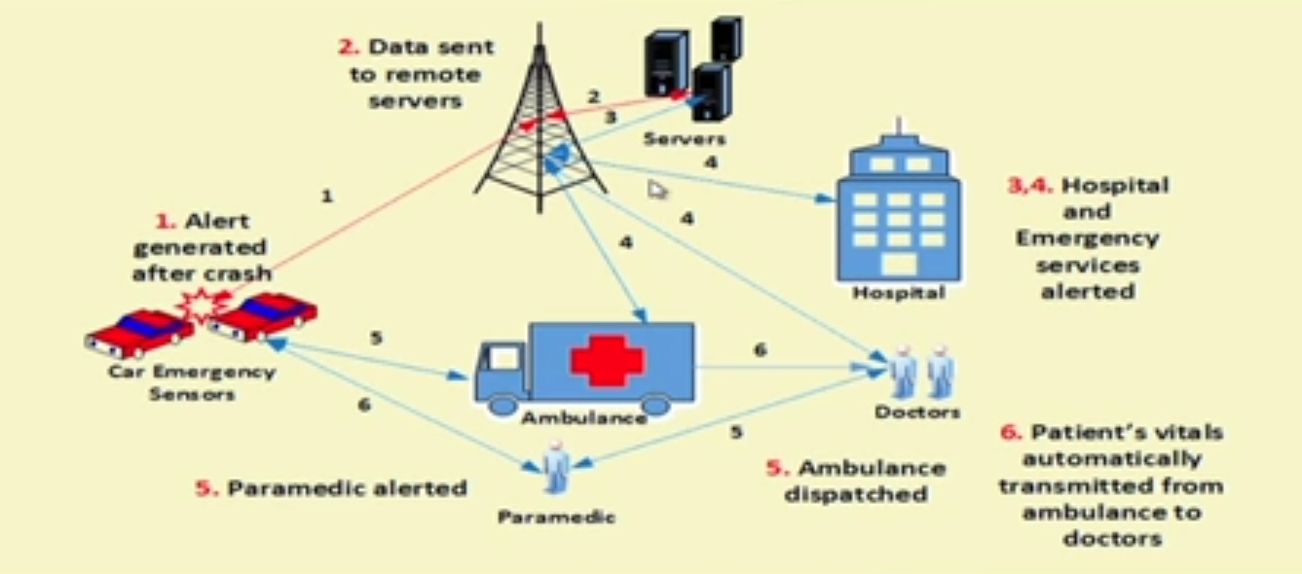

Slide 7
Block Diagram
M2M Area Network
M2M Gateway
M2M Core Network
M2M Application
Automation Devices
M2M Gateway
Wireless Networks

Slide 8
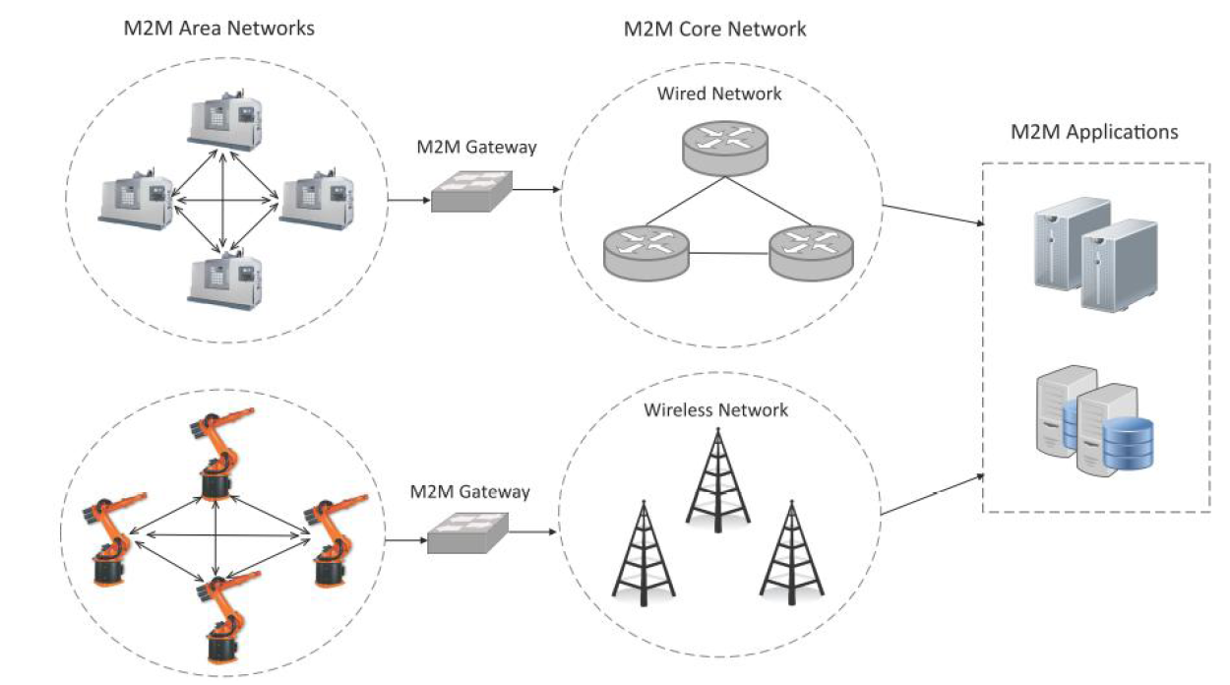

Slide 9
M2M gateway
Since non-IP based protocols are used within M2M area networks, the M2M nodes within one network cannot communicate with nodes in an external network.
To enable the communication between remote M2M area networks, M2M gateways are used that performs translations to enable IP connectivity for M2M networks.
The M2M data is gathered into point solutions such as enterprise Applications, Service Management Applications, or remote Monitoring Applications.

Slide 10
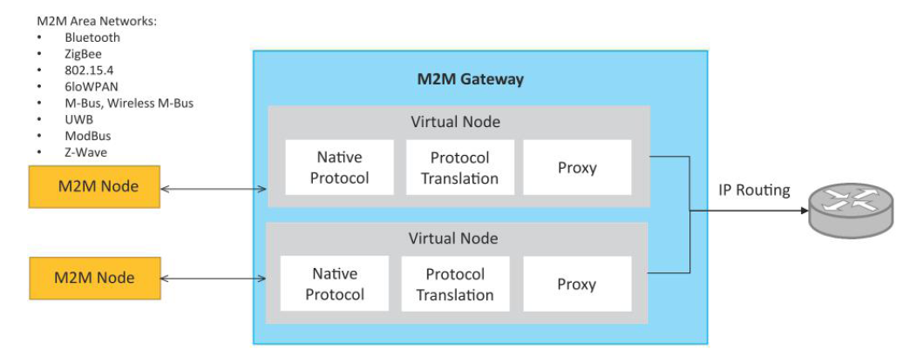
M2M gateway

Slide 11
M2M Application Domain
Smart Metering
Home Automation
Industrial Automation
Smart grids.

Slide 12
Difference between IoT and M2M
Communication Protocols
M2M and IoT can differ in how the communication between the machines or devices happens.
M2M uses either proprietary or non-IP based communication protocols for communication within the M2M area networks.
Machines in M2M vs Things in IoT
The "Things" in IoT refers to physical objects having unique identifiers (IP/ MAC address) that can sense and communicate with user applications or their internal physical states.
IOT systems have heterogeneous things( E.g., a home automation IOT system include various types of IOT devices, fire alarm, door alarm, lighting control devices.)
M2M systems, in contrast to IoT, typically have homogeneous machine types within an M2M area network.

Slide 13
Difference between IoT and M2M
Hardware vs Software Emphasis
While the emphasis of M2M is more on hardware with embedded modules, the emphasis of IoT is more on software.
IoT system run specialized software for sensor data collection, data analysis and interfacing with cloud through IP-based communication.
Data Collection & Analysis
M2M data is collected in point solutions and often in on-premises storage
infrastructure.
In contrast to M2M, the data in IoT is collected in the cloud (can be public, private or hybrid cloud).
Applications
M2M data is collected in point solutions and can be accessed by on-premises applications such as diagnosis applications, service management applications, and on premises enterprise applications.
IoT data is collected in the cloud and can be accessed by cloud applications

Slide 14
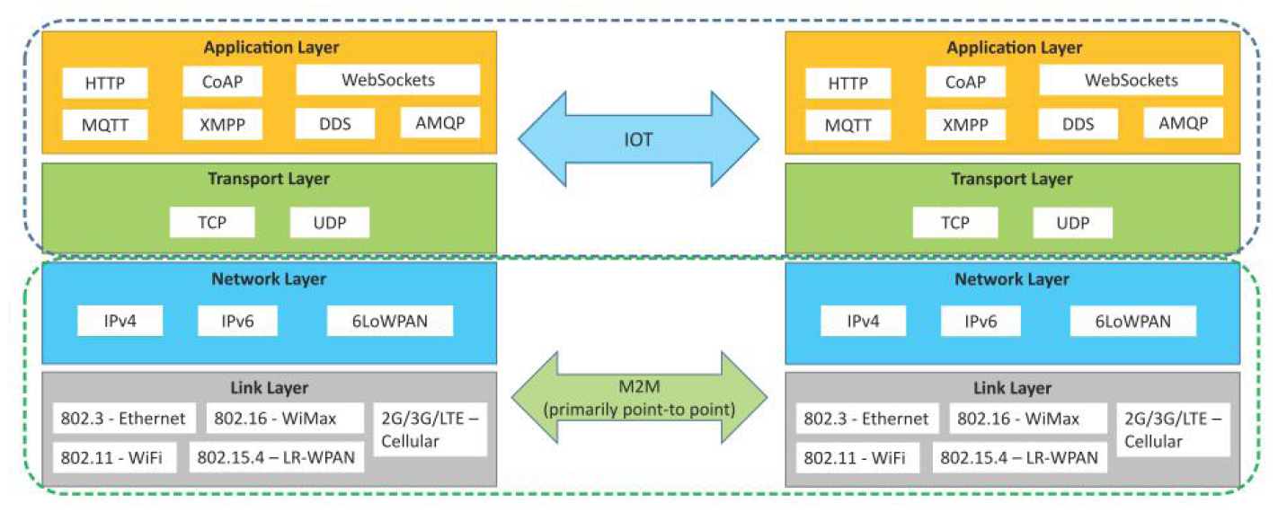
Communication in IoT vs M2M

Slide 15
Overview of the Architecture
Layered communication model for IoT
Based on Internet protocol stack
It Shows 4 layers
1.Application Layer
2.Transport Layer
3.Network Layer
4.Link Layer
It Compares IoT (Internet-based) and M2M (Point-to-point)

Slide 16
IoT Communication Stack
1.Application Layer – Data meaning & messaging
2.Transport Layer – End-to-end delivery
3.Network Layer – Addressing & routing
4.Link Layer – Physical transmission

Slide 17
Application Layer
It defines how devices and applications communicate. The protocols are
HTTP – Web-based communication
CoAP – Lightweight REST for IoT
WebSockets – Real-time communication
MQTT – Publish/Subscribe protocol
XMPP – Messaging protocol
DDS – Real-time industrial systems
AMQP – Enterprise message queuing

Slide 18
Application Layer Models
Communication Models
1. Request/Response
Example: HTTP
Client sends request, server responds
2. Publish/Subscribe
Example: MQTT
Devices publish data to a broker
Subscribers receive updates
IoT commonly uses Publish/Subscribe

Slide 19
Transport Layer
It Ensures end-to-end data delivery.
The Protocols are TCP and UDP
TCP is Reliable, Ordered delivery and Error checking
UDP is Faster, Lightweight and No delivery guarantee

Slide 20
TCP vs UDP in IoT
TCP | UDP
Reliable | Fast
Connection-oriented | Connectionless
Used by MQTT, HTTP | Used by CoAP
Higher overhead | Low overhead

Slide 21
Network Layer
It handles addressing and routing.
The Technologies are
IPv4 – Traditional internet protocol
IPv6 – Large address space
6LoWPAN – IPv6 for low-power devices

Slide 22
Why IPv6 is Important for IoT
Billions of IoT devices require unique IP addresses
IPv4 address space is limited
IPv6 provides:
Massive address capacity
Better scalability
Future-proof infrastructure

Slide 23
Link Layer
Actual physical data transmission.
Technologies:
Ethernet (802.3) – Wired
Wi-Fi (802.11) – Wireless LAN
802.15.4 – Low-power IoT networks
WiMAX (802.16)
Cellular (2G/3G/LTE)

Slide 24
IoT vs M2M
IoT | M2M
Internet-based | Direct communication
Cloud-enabled | Standalone systems
Uses standard protocols | Often proprietary
Highly scalable | Limited scalability

Slide 25
Smart Temperature Sensor Layer Mapping Example
Data Flow: Sensor → Wi-Fi → IP Network → TCP → MQTT → Cloud
Layer | Example Used
Application | MQTT
Transport | TCP
Network | IPv6
Link | Wi-Fi

Slide 26
Benefits of IoT Layered Architecture
Interoperability
Scalability
Flexibility
Cloud integration
Standardization
Supports billions of devices

Slide 27
Overall Idea
IoT uses a layered IP-based architecture
Application layer defines communication style
Transport layer ensures delivery
Network layer provides addressing
Link layer handles physical connectivity
IoT extends traditional M2M systems

Slide 28
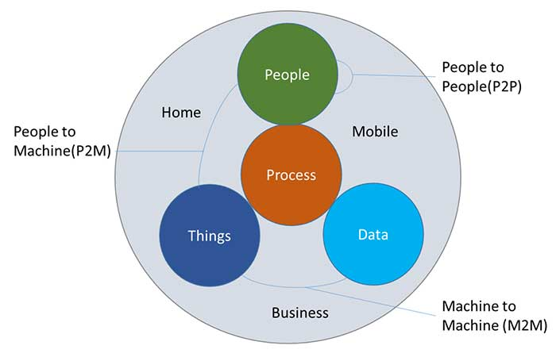
IoE

Slide 29
M2M | IoT | IoE
M2M is a subset of IOT | IoT is a superset of M2M | IoE is superset of IoT
M2M encompasses three key components such asDevices that generate or receive data from other devices Communication for efficient data transfer between devices and gateways An application designed to meet the needs of end users | IOT encompasses four key components such asA sensor or device used to generate or receive data from another device Communication for transferring of data to internet or between devices Storage services, for efficient storage of data into database or to cloud Application to provide intended service | IoE consists of four key components such as people, things, data, and processes
Point to point communication exists between the devices | IP network exists between devices, by integrating various communication protocols | IoE is a network connection of people, data and things
M2M communication may exist without the internet | Devices in IoT require an active internet in most of the cases | Devices and their application require active internet

